Slide 1
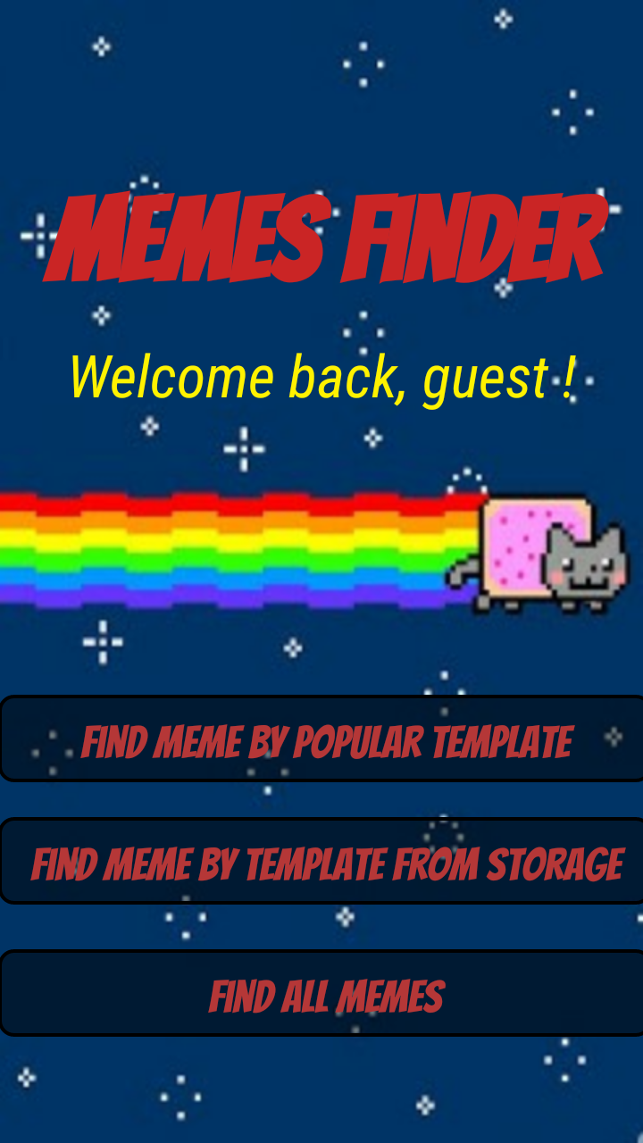

Memes Finder
A presentation for the working product

Slide 2
Overview
Our product is a tool for finding\filtering all pictures of memes from a user’s gallery.
This presentation is a short collection of screenshots/gifs that were taken from our very own application.
For more information about the application, we highly encourage reading our fully detailed book that explains everything you need to know on our application.

Slide 3
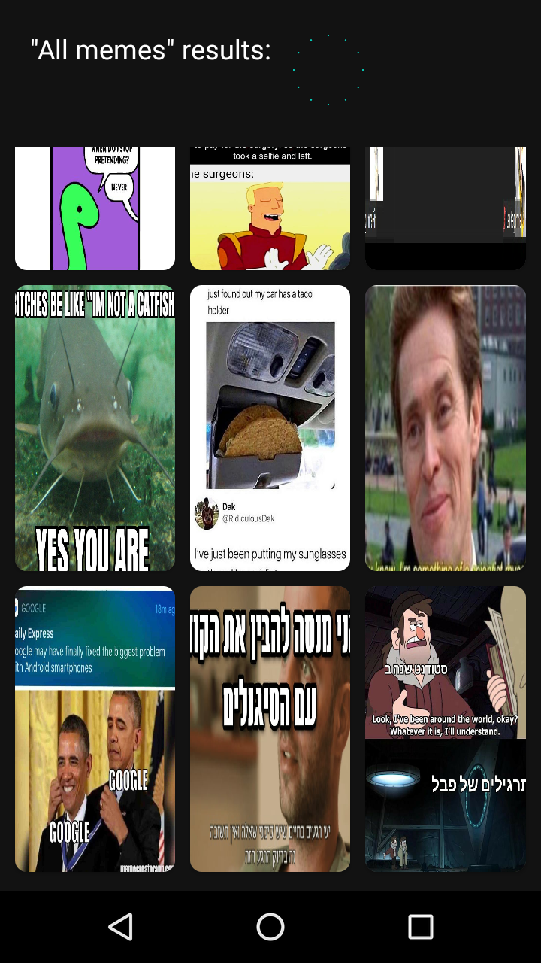
1. “Find all memes”
By pressing this button on the application’s home screen, the user will be exposed to a list of all the memes that are in its gallery.

Slide 4
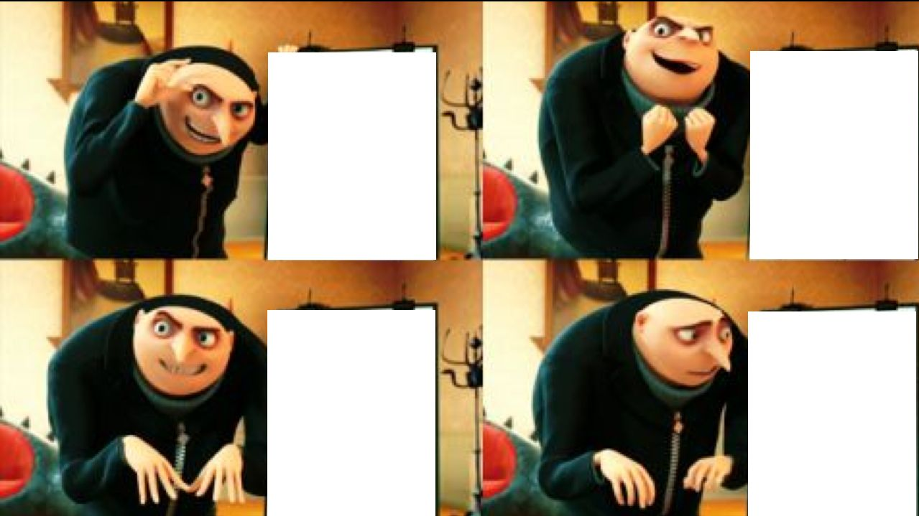
2. “find memes by template from storage”
Allows the to search for memes with a specific template.
This template will be provided by the user from its local storage.

Slide 5
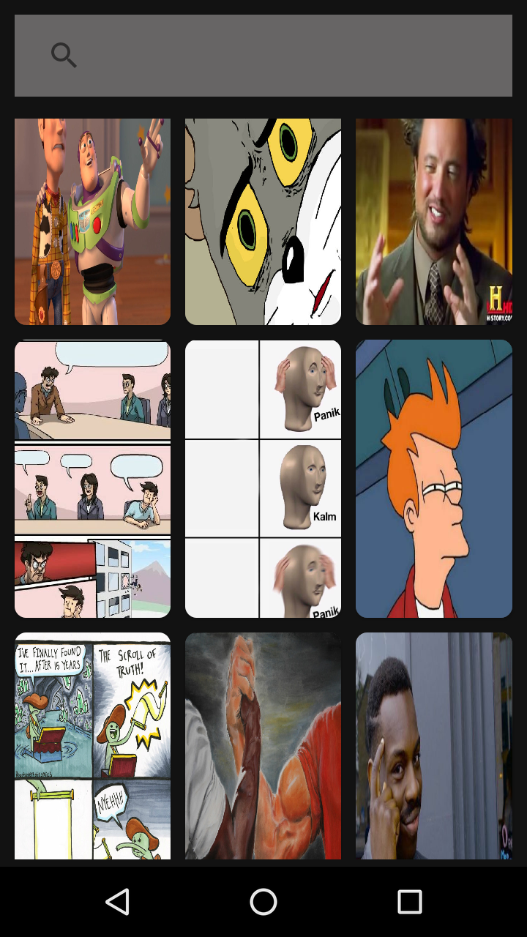
3. “find memes by popular template”
This will allow the user to search a template to filter by. The collection has most of the popular memes.

Slide 6
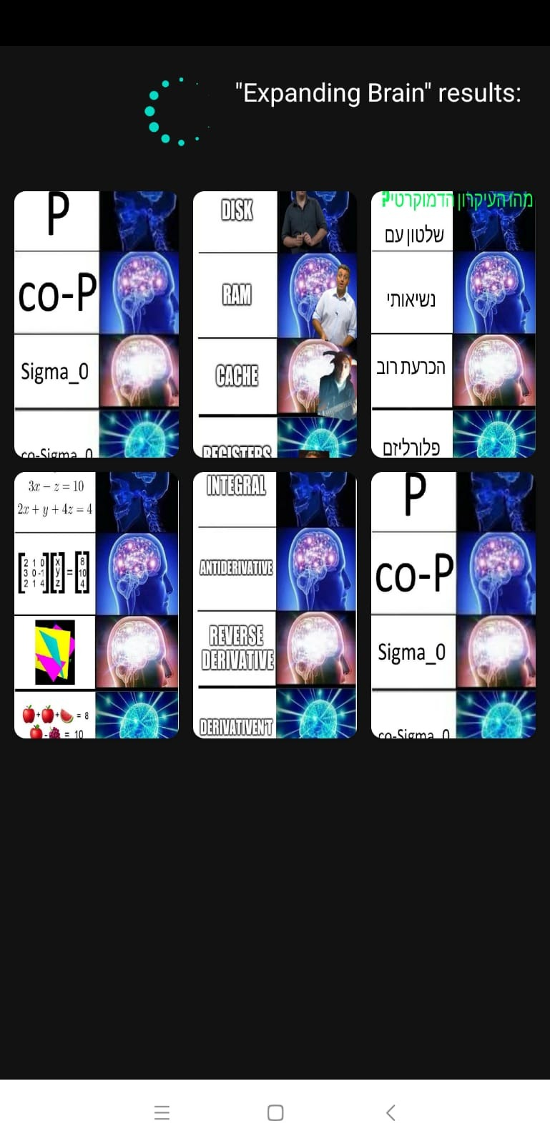
Example – “Expanding Brain”
This example shows the filtering from a popular template.

Slide 7
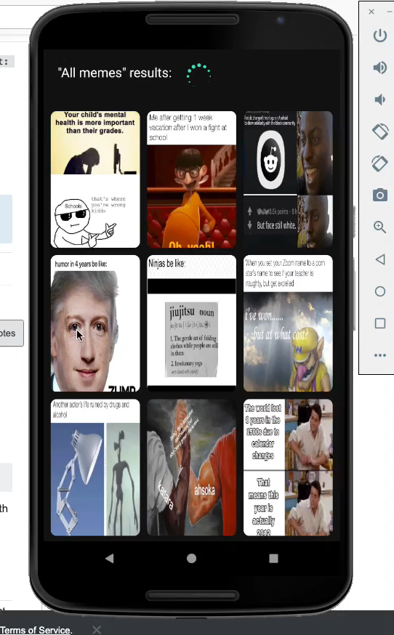
Delete and share.
Our application features a delete function. It helps the user filter out pictures that are not needed anymore.
In addition, our application features a share button to allow the user to share with its friends.

Slide 8
Availability
Our first release of the application is available on our GitHub.
Please visit our GitHub for more information on how we made this application.
Contact us at memeexaminator@gmail.com

Slide 9
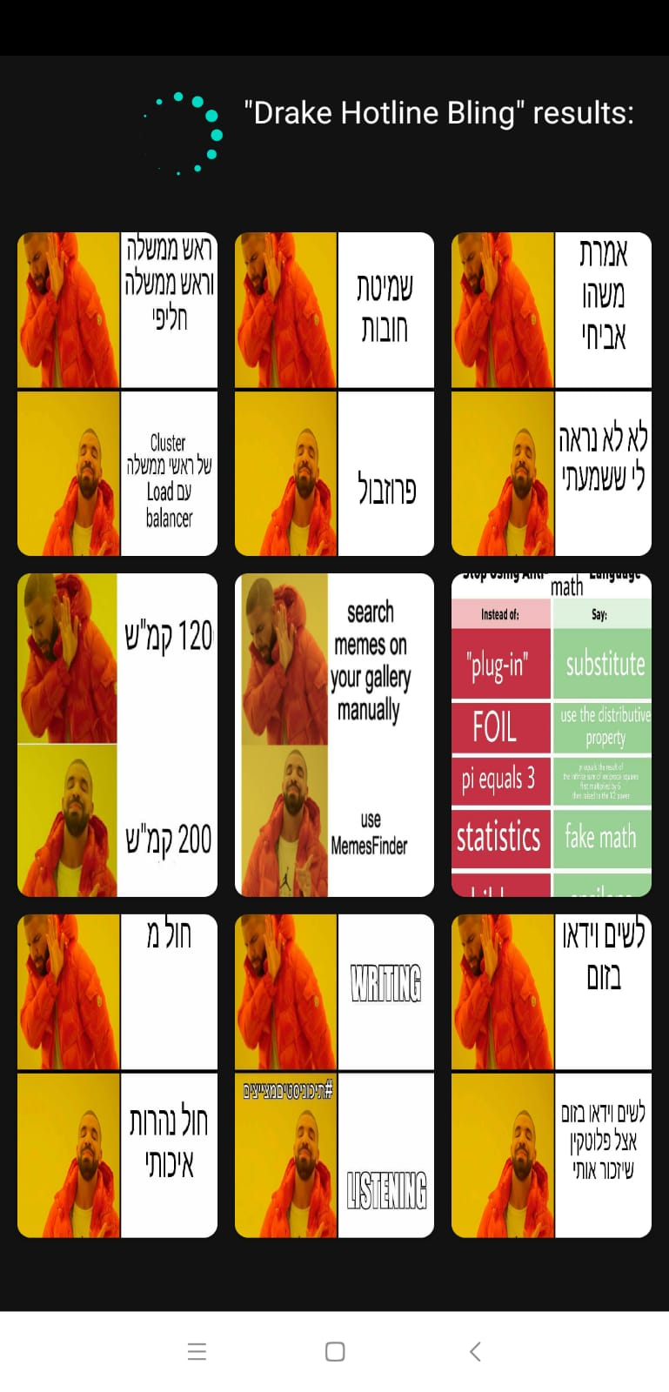
Additional example

